Slide 1
SRSD Day1 worksheet
Instruction: This activity involves a group discussion. Each participant is required to submit their work individually, although it's permissible to submit the same file as their teammate.

Slide 2
Team members
List your team members’ full name (as in your course registration)

Slide 3
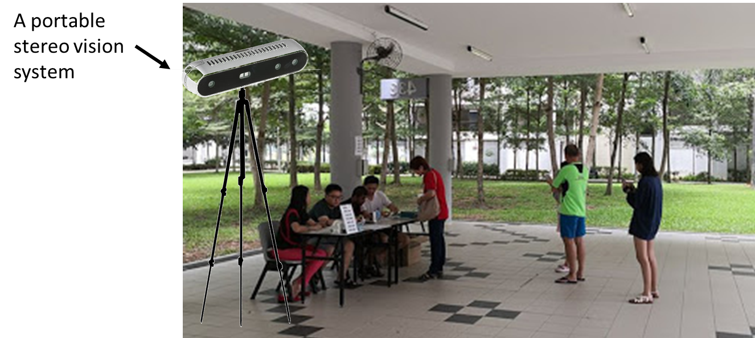
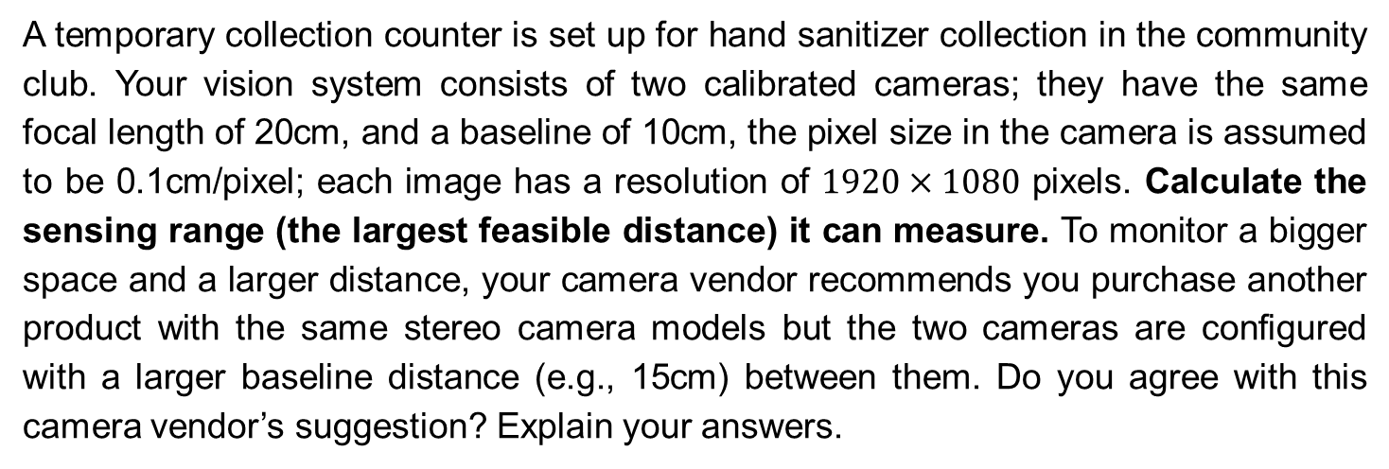
Case study
A temporary collection counter is set up for hand sanitizer collection in the community club. Your vision system consists of two calibrated cameras; they have the same focal length of 20cm, and a baseline of 10cm, the pixel size in the camera is assumed to be 0.1cm/pixel; each image has a resolution of $1920×1080$ pixels. Calculate the sensing range (the largest feasible distance) it can measure. To monitor a bigger space and a larger distance, your camera vendor recommends you purchase another product with the same stereo camera models but the two cameras are configured with a larger baseline distance (e.g., 15cm) between them. Do you agree with this camera vendor’s suggestion? Explain your answers.

Slide 4
Your answers

